Slide 1



Evolution or Revolution –
Captive Insurance & its Role in the Commercial Insurance Marketplace
Keynote Presentation at The Society of Insurance Financial Management
Monday, September 9, 2024 - 9am
Sandy Bigglestone, Deputy Commissioner – Captive Insurance Division
Vermont Department of Financial Regulation

Slide 2
Sandy’s Biography
Graduated from Southern New Hampshire University- B.S. in Accounting
Banking, higher education and hospital finance, auditing and tax before captive regulation
State of Vermont-27 years ago!
Certifications: CPA, CFE, CPM, APIR
Professional Accomplishments
Current Role and Primary Objective
Up Close and Personal

Slide 3

Marketplace Perspective
A.M. Best estimates there are over 7,000 captive insurance companies worldwide (a significant increase from 1,000 or so from 1980)
There are 40 U.S. captive domiciles; 70 worldwide
According to Ernst & Young’s 2024 Global Insurance Outlook Report, “Captives now represent nearly 25% of the overall commercial insurance market”
More than $100 billion in premiums was written through captives domiciled in the U.S. alone in 2022 (Source: Captive Insurance Companies Association)
Captive Review reported, in 2023 $180 billion in premiums were written by captives globally
An article published by Risk Management Magazine November 28, 2023, stated “The captive insurance industry is evolving rapidly, poised to reach a projected $250 billion global market value by 2028.”
90% of Fortune 500 companies today own and operate a captive insurance company

Slide 4
Where are Captives Located?
Source: World Domicile Update 2023, Captive Review, August 2023

Slide 5

Vermont Captive Insurance Marketplace
5
The Global Leader
43 of the Fortune 100
18 of the Dow Jones 30
10% of VT captives have foreign ownership from 23 different countries outside of the U.S.
Over $31 billion in gross written premiums in 2023
43-year history in captives
Over 1,350 captives licensed
680 currently licensed (and growth continues)

Slide 6
Vermont Captives Licensed by Year

Slide 7
What is a Captive?
A limited purpose licensed insurance company
Licensed and regulated in a single state/domicile
Owned by a non-insurance parent
Main business purpose is to insure or reinsure the risks of the captive’s owner(s)
Specifically established to insure or reinsure the risks of its parent or associated third parties
A facilitating mechanism for organizations who want to trade more directly in the risk transfer market
Risk Management Tool
Broad Applications
Formal Risk Financing

Slide 8
Single Parent Captive
Direct Insurance
Parent
Parent pays premiums to captive
Captive insures parent exposure and pays claims
Captive
Reinsurance
Parent pays premiums to
the front
Parent
Front insures the captive parent’s exposure and pays
out claims
Insurance Company
The front reinsures the program with the captive
The captive pays fronting fees and claims
Captive

Slide 9
Group
Captive
Company A
Company B
Company n
Captive (company-owned)
    Homogeneous - member companies from the same industry (e.g. hospitals, construction, transportation)
    Typically created when insurance is very difficult or expensive to obtain
    Risk Retention Groups – special type of group captive that underwrites liability only, enabled by a federal act

Slide 10
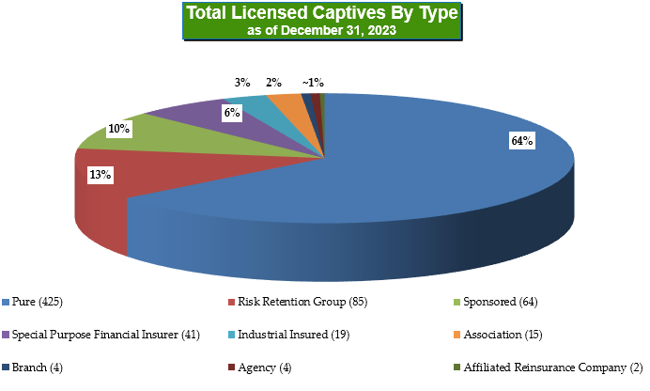

Slide 11

Key Financial Ratios –
All Vermont Captives Aggregated
 |  | 2023 | 2022 | 2021
Loss Ratio |  | 78% | 77% | 78%
Combined Ratio |  | 98% | 94% | 102%
Net Premiums to Surplus Ratio |  | 31% | 40% | 38%
Net Reserves to Surplus Ratio |  | 106% | 121% | 128%

Slide 12
Key Financial Ratios –
Vermont Pure & RRG Aggregated
 |  | Pure Captives |  |  | Risk Retention Groups
 |  | 2023 | 2022 |  | 2023 | 2022
Loss Ratio |  | 72% | 74% |  | 80% | 76%
Combined Ratio |  | 87% | 89% |  | 99% | 94%
Net Premiums to Surplus Ratio |  | 22% | 27% |  | 37% | 47%
Net Reserves to Surplus Ratio |  | 42% | 47% |  | 118% | 123%

Slide 13

The Risk Financing Continuum – Retention v. Transfer
HIGH
Self-Insured Trust
Complete assumption of risk with limited regulation
Single Parent Captive
Complete assumption of risk
Subject to Regulatory Oversight
Group Captive
Program Control
Pooling of Risk with Participants subject to Corporate Governance
Subject to Regulatory Oversight
Deductible Policy
Significant/complete risk assumption in exchange for deductible credit
Retro Policy
Assumption of limited risk in exchange for potential return premium
Deferred “pay-in” premium
Guaranteed Cost
Commercial insurance with no deductible
Complete transfer of risk
HIGH
LOW
Financial Control

Slide 14
Motivations for Establishing Captives
Control
Risk management/monitoring
Program design
Claims handling
Coverage
Flexibility in coverage form vs. prescribed form
Insure difficult risks
Difference in Conditions
Captive
Strategic
Enabler
Capacity
Access to reinsurance
Coverage not
available/affordable
Fill coverage gaps
Regulated Entity
Legal and tax certainty
Premium allocation
Funds set aside for claims
Financing
Financial stability
Cash flow
Investment returns
Embedded profit
Commercial
Complement (not replace) commercial coverages
Leverage the market
Affinity programs
Notes:
Jim

Slide 15
The Feasibility Process
Develop General Framework
Actuarial Analysis
Tax & Legal Analysis
Domicile Analysis
Structure & Pro Forma Outcomes

Slide 16
Captive Utilization – Retention/Deductible Reimbursement
Typical structure for casualty or property retentions
Internal transaction that does not involve the external insurance market
Used to finance current or proposed insurance program deductibles or self-insured retentions
Retained loss costs are financed more efficiently by the captive rather than funding through operating cash flows at the business level.

Slide 17
Captive Utilization –
Participation in Excess Layers
Commonly used when insurance prices are rising, and available capacity is shrinking
The captive provides the necessary capacity, plug gaps in coverage, and/or used to create leverage in pricing negotiations with incumbent insurance markets.

Slide 18
Captive Operations
Essential Functions | Typical Practice
Underwriting and pricing | Owner, usually in consultation with broker, consultant and/or actuary sets lines of coverage and premiums
Claims | Claims adjuster, commercial insurer or self-administered by owner
Accounting/ administration | Captive management company Accounting Annual filing of insurance and accounting records with domicile Communication with regulators
Governance | Board generally includes Treasurer and/or CFO, Risk Manager, outside counsel in domicile, other parent executives

Slide 19

The Role of State Regulation
Traditional Insurers:
Captive Insurers:
Financial Exams
Rates & Forms
Market Conduct
Financial Exams
Plan changes
Financial Analysis
Financial Analysis
Complaints*
*very low volume of complaints due to ownership and insureds being one in the same
Notes:
Amber
So much so that other domiciles consistently attempt to recreate what we’ve achieved here in Vermont
Captive insurers are examined every 3-5 years, subject to annual or quarterly surveillance depending on the risks of the captive.
Not public facing, consumer protection issues are minimal

Slide 20
Vermont’s Regulatory
Model
Communications & Meetings
Licensing
Financial Analysis
Plan Changes & Approvals
Regulatory Examinations

Slide 21

Vermont DFR - Captive Division
Captive insurance is our only business​
30 professional and 2 administrative staff
Over 300 years of combined regulatory experience​
Over 500 years of combined industry experience
12 Certified Public Accountants​
26 Accredited/Certified Financial Examiners​
Many other types of designations ​(financial, insurance, regulatory, captive/ACI)

Slide 22

Questions
Contact Information:
sandy.bigglestone@vermont.gov
(802) 828-4854
https://dfr.vermont.gov/captive-insurance

