Slide 1
What’s on the Minds of Actuaries?
Presented by Bill Wilt (Assured Research) and Mike Angelina (Maguire Academy of Insurance and Risk Management, Saint Joseph’s University
September 9, 2024

Slide 2
Economic Inflation
The economic drivers of liability inflation seem to be moderating.
Medical – top forming
Wage pressures – decelerating
Legal – rising!

Slide 3
Measuring Economic Inflation: Major Liability Components
Reconstituted Medical Trend: 40-60%. Top Forming
Wages: 25-50%. Trend Decelerating
Legal Costs: 10-20%. Trend Accelerating
Notice that the scales are NOT the same from chart-to-chart
Source: BLS via St. Louis Fed (FRED), Assured Research

Slide 4
Measuring Economic Inflation: Liability Trends (Economic)
We’ve weighted the underlying series 27.5% wage, 60% medical, 12.5% legal.
Different mixes might be better suited for different companies.
Volatility seems to be diminishing and the series settling nearer 3%.
The greater concern for measuring or forecasting liability trends: social inflation!
Source: BLS via St. Louis Fed (FRED), Assured Research

Slide 5
Social Inflation
History shows actuaries do a good job of neutralizing the impact of economic inflation through rate increases (when allowed). Social inflation holds greater sway of the liability loss than does economic inflation.
The residual trend is a useful tool for examining/estimating the impact of social inflation.
Residual trend for liability is positive, but decelerating(?)

Slide 6
Non-Economic Damages >= Economic Damages. Social Inflation!
We reviewed 46 legal cases disposed in ’22/’23 (across a variety of claim types and venues) and found that non-economic damages accounted for 65% of total values.
And those are cases settling for less than $10 mil.; at larger the award values non-economic swamp the economic component.
Our metrics are calibrated on a small sample size; we offer them as rough guide that should be informed by company data
Source: VerdictSearch, Assured Research. 46 legal cases disposed in 2022/2023

Slide 7
Residual Trend Lends Insight into Pricing and Reserving
The residual trend examines the growth in losses after removing growth from the economy (real GDP) and economic inflation.
Periods of high and sustained (positive) residual trend correspond to known bouts of social inflation (arrows).
Notice that the residual remained positive for several years in most instances.
Data = Other + Product Liability (Occ and CM)
Liability: RT is 8% since 2018; Moderating?
Source: ©2024 S&P Global Market Intelligence, Assured Research

Slide 8
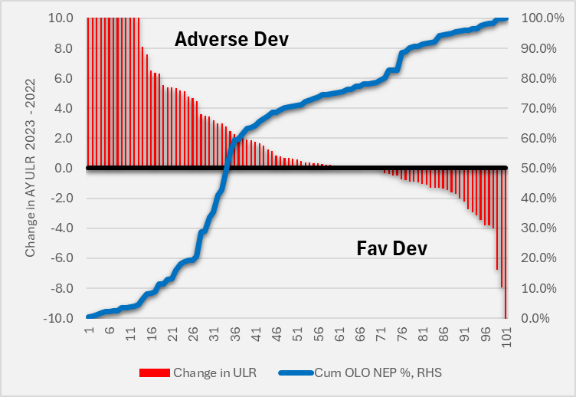
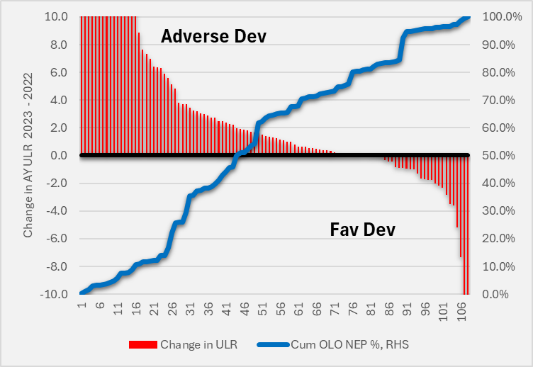
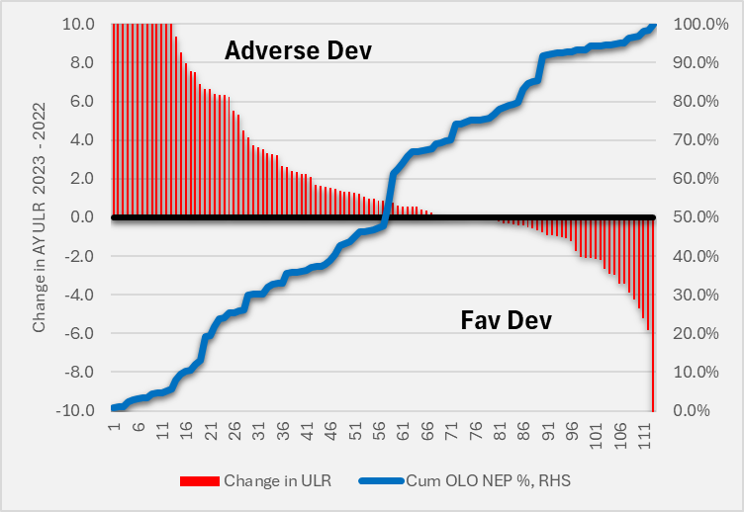
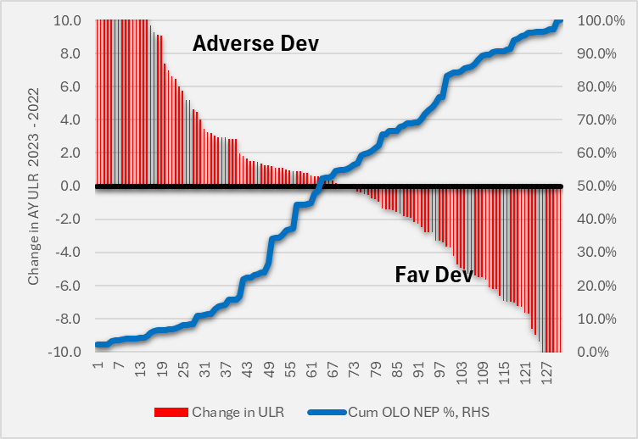
Other Liability Occurrence: Change in ULRs CY23 – CY22
There’s not a material difference in the development of ULRs for AYs 17-19. Perhaps most notable is that AY22 developed adversely in CY23 for such a large % of companies. Our YE23 reserving work placed a deficiency on AY22 of 2.4 loss ratio points…so more to come we think.
AY17
AY18
AY19
AY22
Source: ©2024 S&P Global Market Intelligence, Assured Research

Slide 9
Residual Trend Lends Insight into Pricing and Reserving
The residual trend examines the growth in losses after removing growth from the economy (truck tonnage units) and economic inflation.
The CAL residual trend is still rising strongly. Pricing needs to account for exposure, economic inflation AND residual inflation.
Commercial Auto Liability: RT is 7% since 2018 but Rising
Source: ©2024 S&P Global Market Intelligence, Assured Research

Slide 10
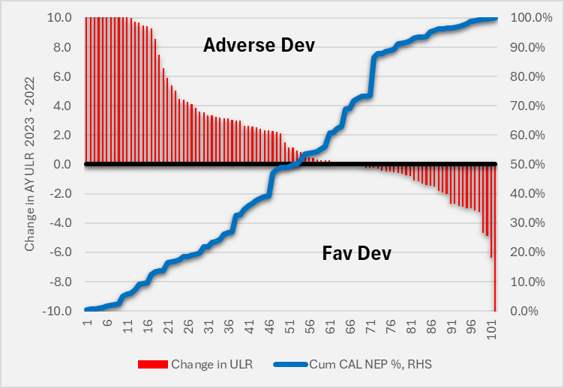
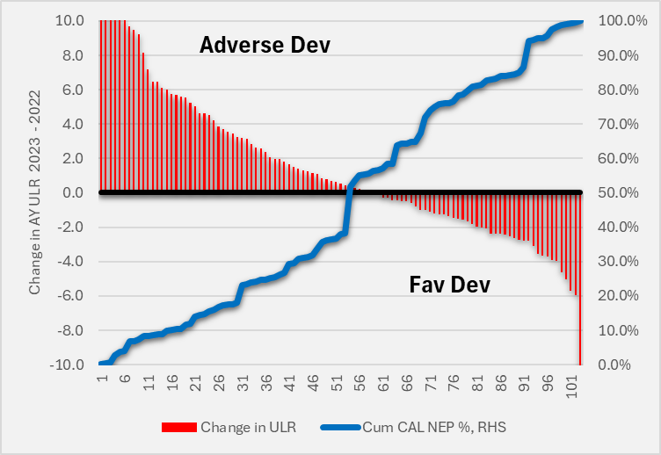
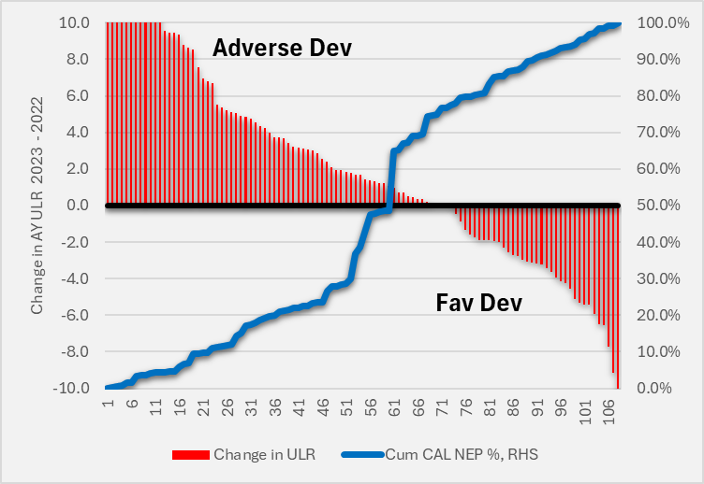
Commercial Auto Liability: Change in ULRs CY23 – CY22
It’d be tough be put a positive spin on anything CAL-related. Our reserving work pointed to a $5.4 bil. deficiency with 5-6 points of ULR shortfall on AYs 22-23. Companies writing 70% of CAL premium reported adverse development on AY22 in CY23!
AY19
AY20
AY21
AY22
Source: ©2024 S&P Global Market Intelligence, Assured Research

Slide 11
Reserve Adequacy
The P/C industry has released reserves for 18 (!) consecutive years. The sum total of released reserves is $154 bil. or about 1.6 loss ratio points (industrywide).
But cracks are beginning to emerge!

Slide 12
P&C Loss Reserves: Keep Calm and Carry On
We estimate the industry’s carried reserves on accident years (“AY”s) 2014-2023 are redundant by about $11.7 billion, or 1.4% of carried reserves (for loss + defense and cost containment, or L&DCC).That’s about ½ the redundancy we’ve pointed to each of the past three years.
Our work doesn’t include analysis of years or liabilities prior to 2014 and we’re not attempting to account for any of the mass tort actions currently in various stages of legal development (oftentimes with bankrupted corporate entities).
Source: ©2024 S&P Global Market Intelligence, Assured Research

Slide 13

Favorable PPD has averaged about 2.5% of Premiums
Although a number of reserves charges at YE23 and into 1H24 shook the confidence of the investment and insurance communities.
P/C reserves have developed favorably for 18 consecutive years. Will YE2024 break their winning streak?
We don’t think so…thank you, workers’ compensation! (And probably private passenger auto.)
Cohort of 35 publicly
traded P/C Cos.
Source: ©2024 S&P Global Market Intelligence, Assured Research

Slide 14
Dashboard: Workers’ Compensation
Favorable/Adverse Co. Ratio: 4.6
Our YE22 reserve analysis pointed to an $11 billion redundancy while $6 billion of favorable development emerged in CY23 (a level similar to recent years). Why on earth does this continue to happen?
Favorable megatrends include: 1)reductions in opioid Rx; 2) rising % of medically insured post ACA; 3) realized medical trend below provisions (e.g., 2-3% vs 5%), 4) smart applications of technology, medical triage, RTW programs, 5) wage inflation > medical inflation
We forecast more of the same for WC in 2024.
Source: ©2024 S&P Global Market Intelligence, Assured Research

Slide 15
Dashboard: Commercial Auto Liability
Red!
Favorable/Adverse Co. Ratio: 0.6
Our YE22 reserve analysis pointed to a $1.1 billion deficiency while $3.0 billion of adverse development emerged in CY23. Our new estimate is a $5.4 billion deficiency.
What’s going on? Commercial auto has been ground zero for social inflation. We asked a prominent defense attorney why:
Obviously, the mechanism and extent of injury in these types of cases can be tremendous, and a jury pool may already have biases based on their own experiences on the road. I believe part of the reason for the increase in claims in this industry is the perception that we will settle everything without going to trial.
Source: ©2024 S&P Global Market Intelligence, Assured Research

Slide 16

Dashboard: Other Liability Occurrence
Provisioning for development more conservative than past
Favorable/Adverse Co. Ratio: 0.7
Our YE22 reserve analysis pointed to a $4.7 billion deficiency while $4.7 billion of adverse development emerged in CY23. Our new estimate is a $6.4 billion deficiency…so what changed?
What’s happening? 1) Social inflation, 2) lengthening development patters (changing legal tactics, court closures, etc.), 3) changing dynamics in insurance towers…pressure by insurers high on insurers lower in the tower to settle…even if liability could/should be challenged.
Source: ©2024 S&P Global Market Intelligence, Assured Research

Slide 17
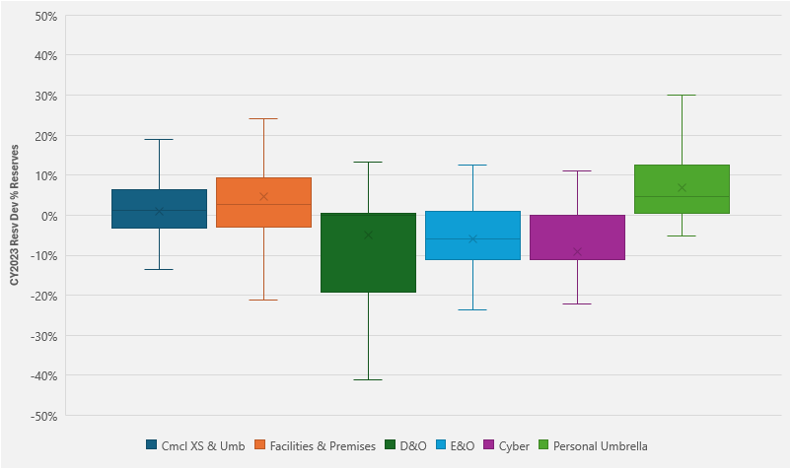

Where is the Liability Development Coming From?
In 2023, from commercial excess and umbrella and facilities/premises policies…and personal umbrella.
Adverse development NOT coming from D&O/E&O.
Source: ©2024 S&P Global Market Intelligence, Assured Research

Slide 18
Much of the Worst Experience Being Ceded to Reinsurers
Gross ULRs
Ceded ULRs
Net ULRs
Source: ©2024 S&P Global Market Intelligence, Assured Research

Slide 19
Largest Reserve (Decreases) Increases in Cal. Year ‘23
Workers’ Compensation
Commercial Auto Liability
Other Liability Occurrence
Company | WC, $000
Travelers | $(903,920)
State Compensation Ins Fund | $(446,483)
The Hartford | $(326,957)
W. R. Berkley Corp. | $(250,027)
Berkshire Hathaway Inc. | $(235,654)
CNA | $(214,053)
Liberty Mutual | $(208,389)
Chubb | $(206,496)
Old Republic Insurance | $(191,332)
Zurich | $(176,588)
Company | CAL, $000
Progressive | $ 378,858
State Farm | $ 355,809
American Transit Insurance Co. | $ 220,379
Chubb | $ 194,752
Allstate Corp | $ 191,314
Travelers | $ 179,129
Berkshire Hathaway Inc. | $ 166,849
Everest Re | $ 139,829
W. R. Berkley Corp. | $ 130,180
Fairfax Financial | $ 98,492
Company | OLO, $000
Travelers | $ 883,234
State Farm | $ 731,509
Liberty Mutual | $ 538,497
The Hartford | $ 425,177
Chubb | $ 420,387
AXIS | $ 282,998
Markel | $ 276,052
Nationwide | $ 271,196
Fairfax Financial | $ 239,692
STARR Cos. | $ 197,915
Our point in showing is not to single out individual companies, but rather to make the point that
reserves actions have been widespread with a material component of systemic (industrywide)
reserving challenges
Source: ©2024 S&P Global Market Intelligence, Assured Research

Slide 20
Personal Umbrella Policies
The personal umbrella market is small at $5.8 billion, but it provides peace of mind to many policyholders.
Insurers have recently been losing money on this product! The vast majority of personal umbrella losses come from auto claims.

Slide 21
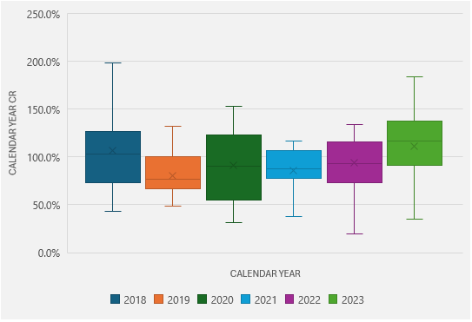
Personal Umbrella Calendar Year Combined Ratios
Distribution of 2018-2023 CRs across 20 Cos Writing ~45% PU Premiums
Everything seemed mostly Ok until 2022 and 2023
State Farm dominates this line at ~21% share. The co. reported a $1.1 bil U/W loss in ’23 on $1.3 bil. premiums
Source: ©2024 S&P Global Market Intelligence, Assured Research

Slide 22
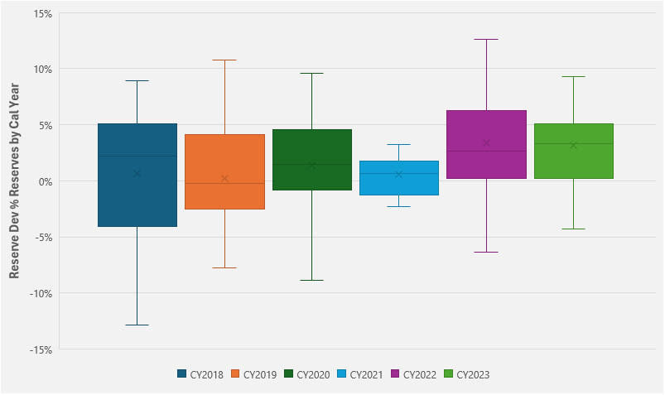
Personal Umbrella Reserves Developing Adversely
Our cohort of personal umbrella writers are showing more consistent adverse reserve development.
Again, the product is dominated by State Farm, Allstate, and Farmers collectively writing about $2.5 bil. of premiums or 42% of this total $5.8 bil. line of insurance.
Adverse Development > %
Favorable Development < %
Source: ©2024 S&P Global Market Intelligence, Assured Research

Slide 23
Personal Umbrella Rate Filings Recently Requesting 18%
The number of rate filings in 2024 appears to have slowed (though some of that may be the lag in S&P harnessing the data).
Irrespective, the requested rate hike has averaged 18% over the past 3 quarters and more than 15% since mid 2022.
This is not a major line by premium (at ~$6 bil.) but it adds peace-of-mind to lots of policyholders buying the coverage.
Source: ©2024 S&P Global Market Intelligence, Assured Research

